Slide 1
CS 3337 Group 5 Project Proposals
By Elliot Gong, Alan Mai, Alejandro Vargas, Vivian Casas, Darshan Patel, Isidoro Flores, Deion Stapleton, Brook Alamnew, Siying Chen, Christopher Renteria

Slide 2


Overview
Darshan
Examined existing digital services/applications used by the Los Angeles Department of Public Social Services.
What are some difficulties users encounter in these products?
Improve or invent new software to solve identified problems.

Slide 3
Proposal 1: Welfare Locator
A geospatial service to help locate nearby welfare/assistance.

Slide 4
Situation
Users
Isidoro
People who want to apply for government services
“At risk” individuals looking for jobs, rehab or shelter.
Recently incarcerated people seeking reintegration assistance.
People displaced by natural disasters.
People are uninformed of welfare programs available nearby.
There is also a growing rate of homelessness, incarceration, and underemployment in Los Angeles.
Notes:
Isidoro Flors

Slide 5
Target
Features
Isidoro
Our objective is to provide our user with this information at their palm of their hands
To facilitate the reintroduction process for previously incarcerated people.
Streamline disaster relief or and emergency response
Faciliate the local job searching process.
Our app aims to have a map with these locations highlighted
Means to travel to such location
A digital “help wanted” sign and “one” click application process
Notes:
Isidoro Flores

Slide 6
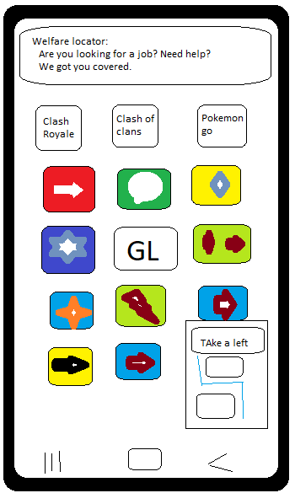
Option 1: Mobile App - Android
Alan*
Pros:
Access to GPS for exact location for easier navigation to resources
Some app feature could function offline or with limited internet access
More personalized user experience like push notifications for resources or in-app communications
Cons:
Exclusive to mobile phones
Less information so that it can fit to mobile format
Require user to download a app

Slide 7
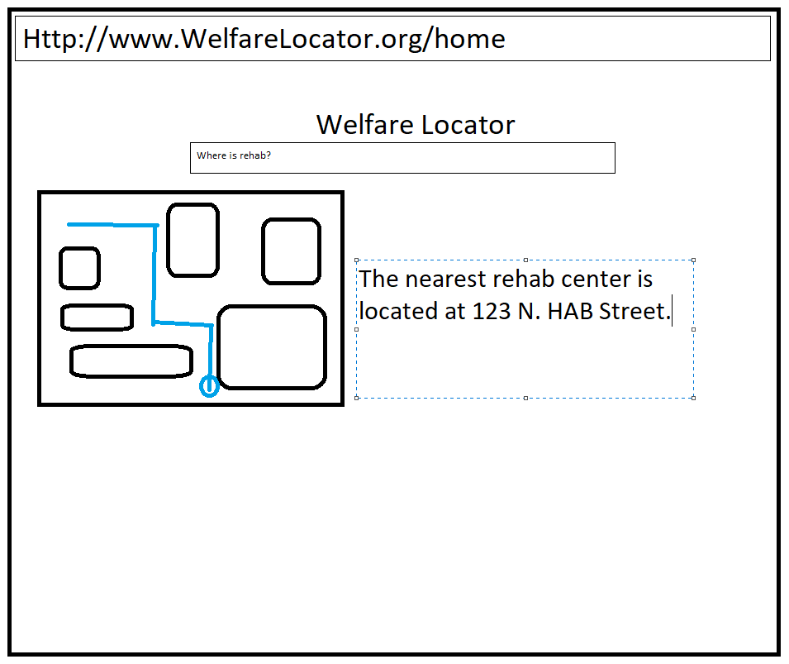
Option 2: Website
Alan
Pros:
Can be used on both desktop and mobile
Easier to navigate due to more info being able to be displayed
No need to download anything would only need a URL to find website
Cons:
Has access to GPS, but doesn’t give you step by step instruction in real time
Requires internet in order to be used.
Not a lot of notification method on website except for popups

Slide 8
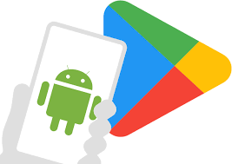
Proposal 1 - Option 1: Welfare Locator Mobile App for Android/Google Play Store
Deion S
This app will give user access to offline or limity connection features in the app, like maps, preload text, and more.
With the mobile app, users can easily engage in direct communication with appointed/official individuals with haste.
Notifications are more visible and apparent on the mobile device then on desktops.
It’s easier to optimize mobile-native software than those regulated to traditional web browsers.
Notes:
She wanted us to write about how this product will help and not about what the app can do

Slide 9
Proposal 1 - Option 1 - Details
Database (MongoDB/MySQL)
System/Interface Specs
Elliot G.
Users
Saved/Bookmarked locations
Uploaded Files
Business Posts
Welfare/businesses
Digital services/content
Descriptions/Summaries
Reviews and comments
Google Maps/Yelp API to locate existing addresses that provide welfare services
Federal Offices
Private firms
Volunteer Organizations
Search function and filters(business type, hours) to find desired results.
Notes:
Isidoro Flores

Slide 10
Proposal 2: CityMeet
An media/engagement platform for districts and townspeople to discuss and post.

Slide 11
Situation
Users
Alejandro & Elliot
Communities want to stay on top of situations affecting the area.
For example power going out, water troubles, and construction projects.
There are still people who aren’t informed of what events/pop-up organization is happening locally
People feel they might be discriminated against in their current environment
People who wish to hear about trending stories/events in their area.
People who wish to discover new places nearby.
Potential vendors who want to open a private business.
Concerned individuals in times of crisis

Slide 12
Target
Features
Alejandro & Elliot
Find more attractive alternatives to legacy media to satisfy their consumption of news/current affairs.
To have more reliable reporting/fact-checking.
Having ways to be more involved in their community.
Account-based system to store user data/preferences.
Geospatial integration to keep track of where posts were made.
The ability to create and follow groups, boosting community driven engagement.

Slide 13
Option 1: Mobile App - Android
Alejandro
Pros:
In new media having a mobile app will allow for this to thrive because mobile apps can provide a more interactive experience compared to web apps
A better connection with the users will allow for feedback in creating a better community and knowing what the people want
Because this is a community centered app local businesses can boost brand awareness
Cons:
A mobile app will have a high development cost and time due to the fact we will use more technologies and will face more challenges due to platform specific implementations
It would be heavily reliant on it being community driven and depending on the area there might not be much to talk about or for businesses to open
User Acquisition unfortunately like other government services this might be lost in the sea of other government services

Slide 14

Option 2: Website
Vivian
Pros:
Easier updates - updates and new features can be rolled out instantly without requiring users to download updates from the app stores.
Cost-effective development - developing and maintaining a single website can be more cost-effective than opposed to a mobile app.
Cross-platform compatibility - A website can work across different operating systems, browsers, and mobile devices as long as there's access to an internet connection.
Cons:
Digital Divide - some members of the community may not know how to navigate the internet, have quick access to it, or feel comfortable potentially excluding members of the community.
Push Notifications - not all browsers support push notifications and they can be less reliable and may not always reach users.
Doesn't have the reach a mobile app does - the websites may face limitations in getting visibility and attracting new users as opposed to a mobile app on an app store.

Slide 15
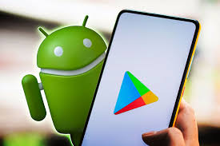
Proposal 2 - Option 1: CityMeet Mobile App for Android/Google Play Store
Deion S
It’s easier for users to capture spontaneous events and unexpected moments with a mobile device.
A mobile app would be more easily scalable and deployable.
Users who migrate from other social media platforms can easily transition to our product using our simple user interface.

Slide 16
Proposal 2 - Option 1 - Details
Database (MongoDB/MySQL)
System/Interface Specs
Elliot G.
Users
Published/saved content
Contact info
Groups
Members
Posts/announcements
Settings
Feed
Caption Tags
Location tags
Geospatial API to keep track of where posts were made.
Social Media API(Facebook, Instagram, Snapchat) to build build product features.
Search function and filters(media type, tags) to find desired results.
Notes:
Isidoro Flores

Slide 17
Questions?
Feel free to ask

